Slide 1

Knut
Agent

Slide 2
Concept
Time-based
Maximum
Average Tit 4 Tat based on opponents change
Random above minimum target
Always look to accept
Notes:
Time-based: Changes strategy as time goes by
Maximize utility for some time. Plenty of time to negotiate, so why not ask for maximum utility for a while?
See how the opponents bid changes, and respond with the same kind of behaviour
When time runs out, go for random bids above a defined minimum target to try close a deal
For every bid that I respond with, I always check that if my bid has a higher utility than the last received offer. If not, then I accept the last offer. Towards the end I change and check if the utility of the last received offer is above a minimum target, and if so, I accept it.

Slide 3
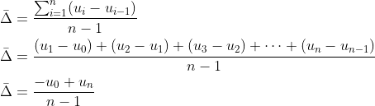
Average T4T
Notes:
The average change is based on this simple equation, where n is the number of bids received inside a time-window.
The average change between bids can be calculated as the difference between the last and first bid, divided by the number of changes, i.e. n-1
So as you see, if the opponent is gradually working towards giving me a higher utility, I will respond with trying to give the opponent a higher utility as well, and visa versa.
This equation is highly dependable upon the size of the time-window, and as I expect to see greater changes towards the end, I make the time-window smaller as we get closer to the end.

Slide 4
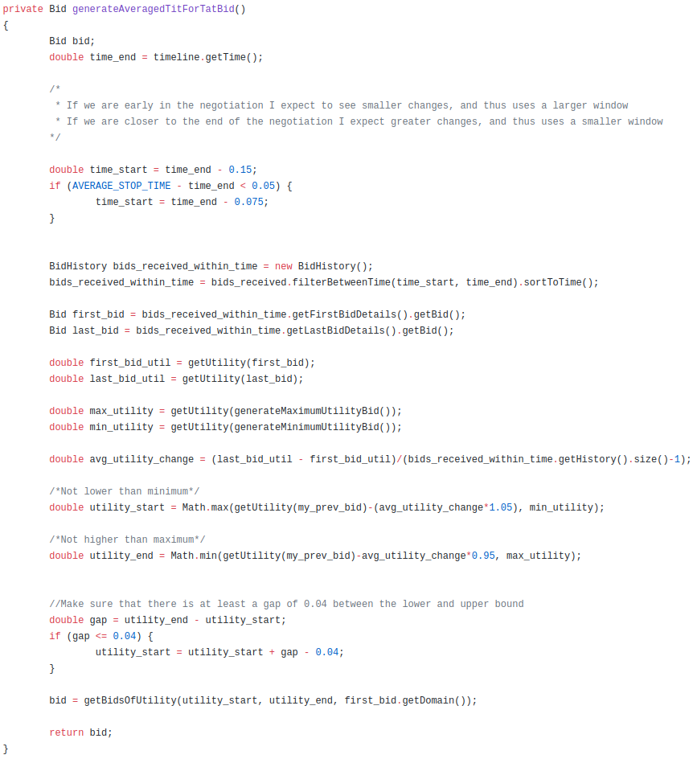

Slide 5
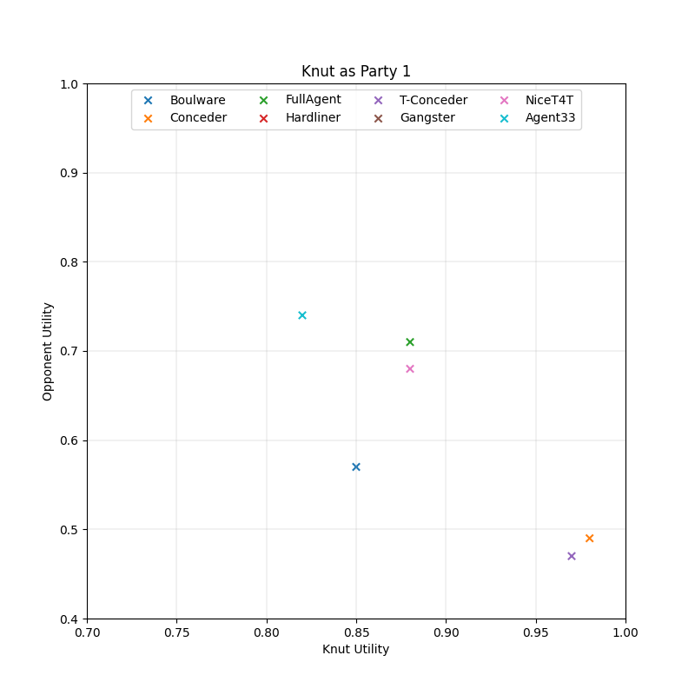
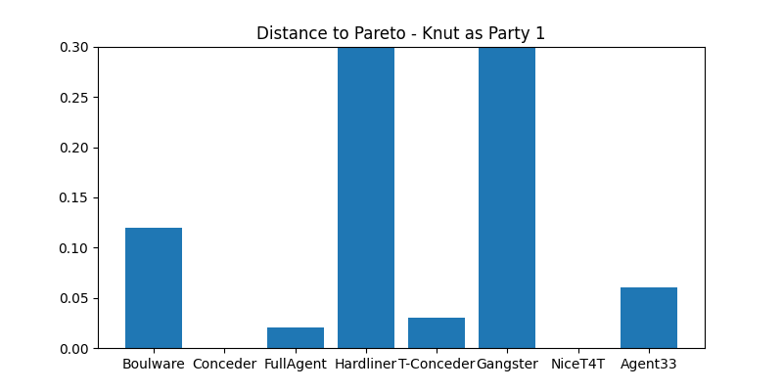
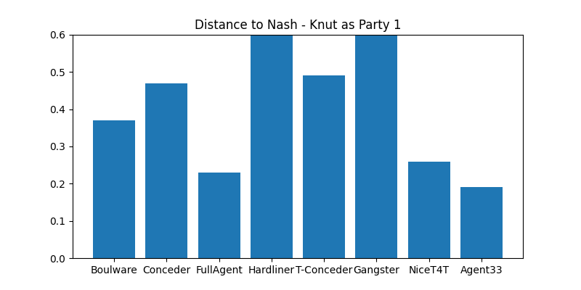
Notes:
I tested my agent against 8 different other agents as Party1, and Party2.
For the Party1 case you can see that KnutAgent comes to an agreement with 6/8 other agents, with a minimum utility of about 8.2. It did not manage to reach a utility of 1 with the two different conceeders.
The Hardliner and Gangster agents were too strict, and thus we could not come to an agreement.
You can also see that in most cases the distance to the pareto frontier was quite small.

Slide 6
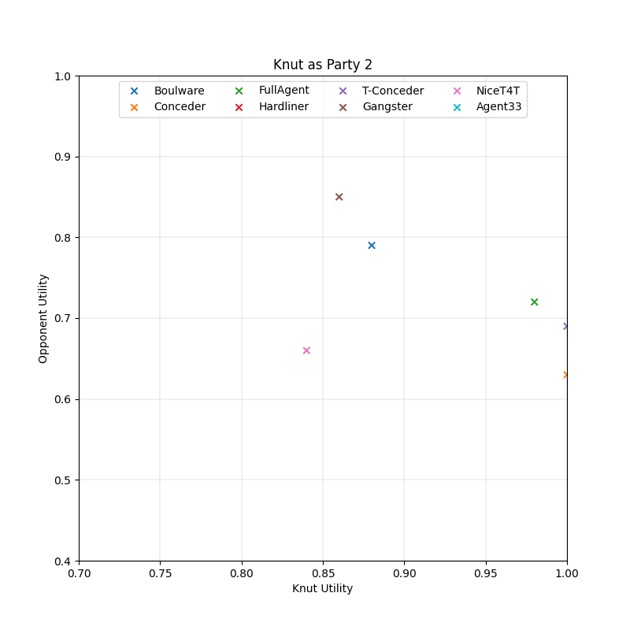
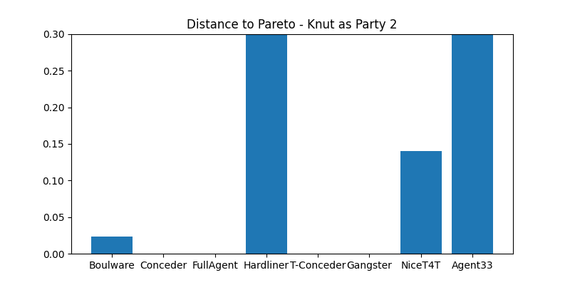
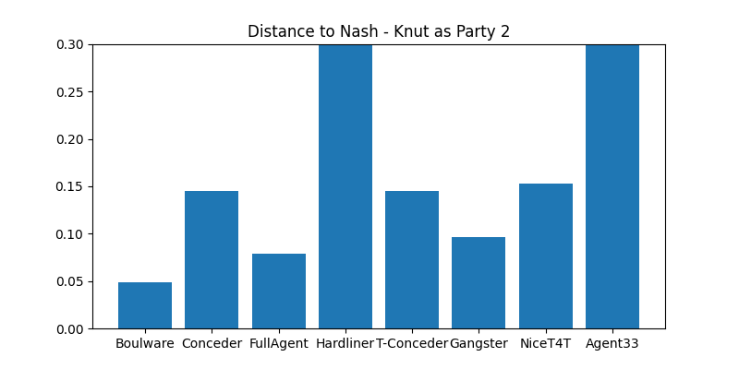
Notes:
For the Party2 case you can see that KnutAgent also comes to an agreement with 6/8 other agents, with a minimum utility of about 8.4. Contrary to party1, It did manage to reach a utility of 1 with the two different conceeders.
The Hardliner and Agent33 agents were too strict, and thus we could not come to an agreement.
You can also see that in most cases the distance to the pareto frontier was even smaller, which in addition to the slightly higher utility received, might indicate that the KnutAgent is a bit better when the opponent starts the negotiation

